Slide 1
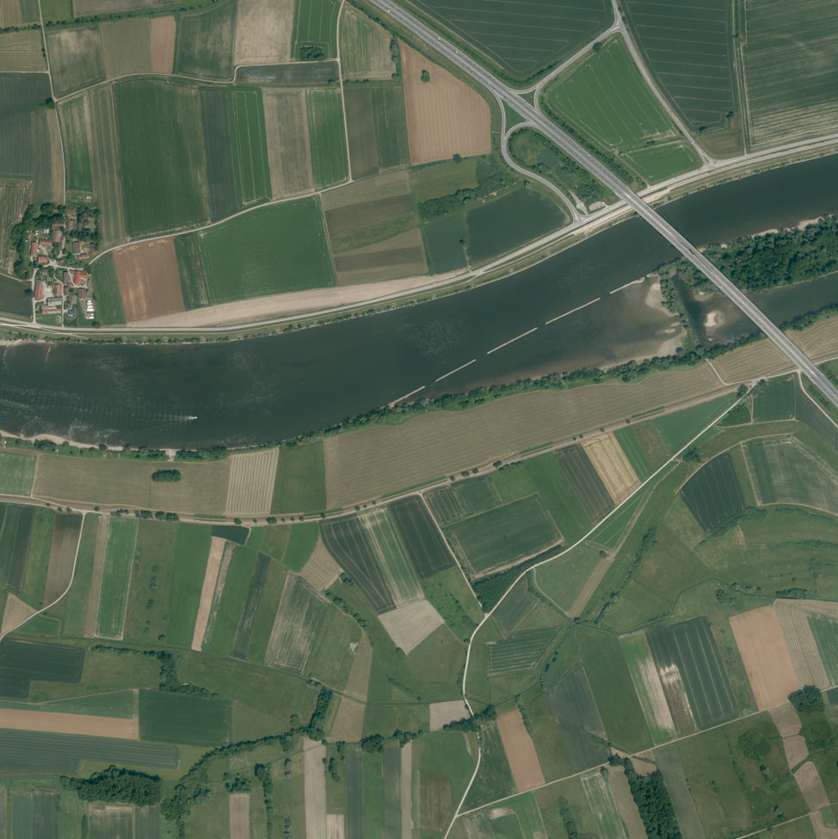
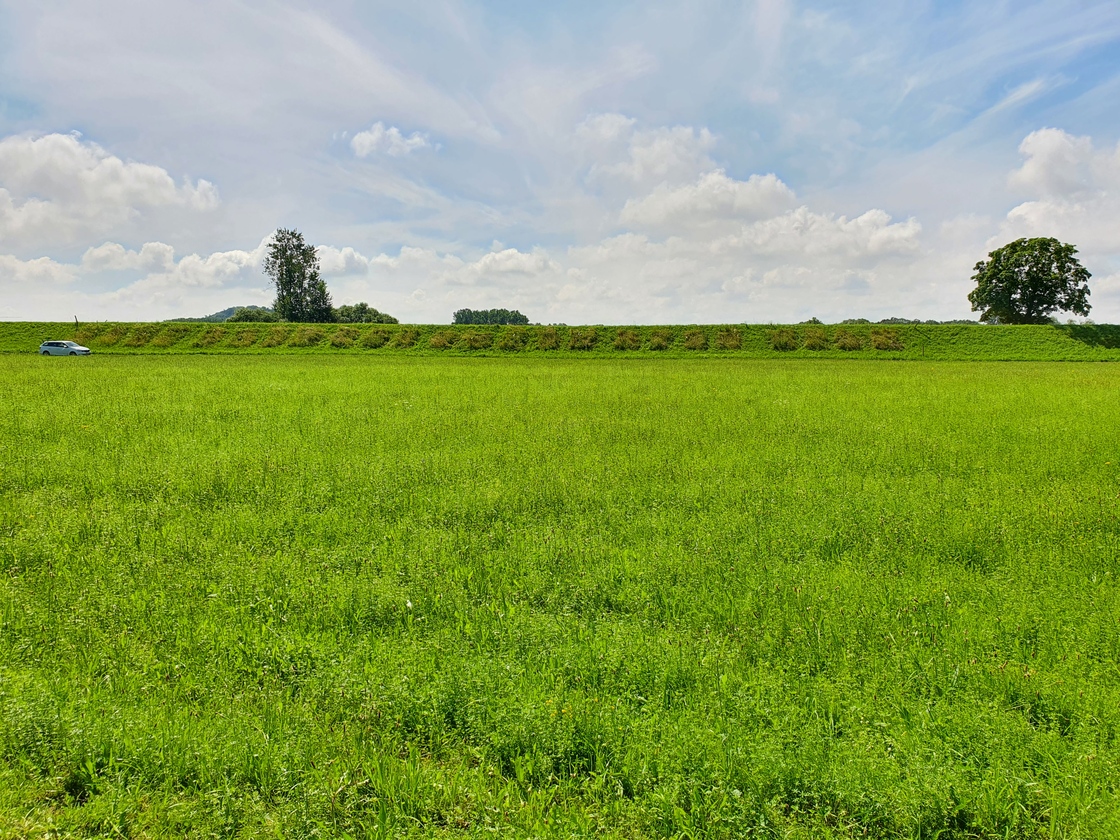
6
5
3
4
1
2
BayernAtlas
100 m
Sand admixture:
0%
25%
50%
Block 5
Dike top
Substrate depth:
15 cm
30 cm
Street on berm
50 m
Seed density:
4 g m⁻²
8 g m⁻²
BayernAtlas
48 plots per block:
North / Water side
D
H
D
H
D
H
H
D
D
H
H
D
D
H
H
D
D
H
D
H
D
H
D
H
Dike top
D
H
D
H
H
D
D
H
H
D
D
H
H
D
D
H
H
D
H
D
D
H
D
H
2 m
South / Land side
Street on berm

